Slide 1
Unleashing the potential of ecotourism in Malaysia
Malaysia
A preferred ecotourism destination

Slide 2
Unleashing the potential of ecotourism in Malaysia
What is Ecotourism?
Ecotourism Development in Malaysia
Does Malaysia have the potential for Ecotourism Development?
What Are The Challenges Ahead?
Enhancing the value of Ecotourism In Malaysia
The Role of the Malaysian Ecotourism Association (MEA)

Slide 3
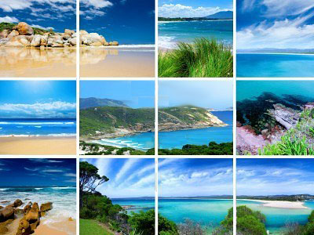
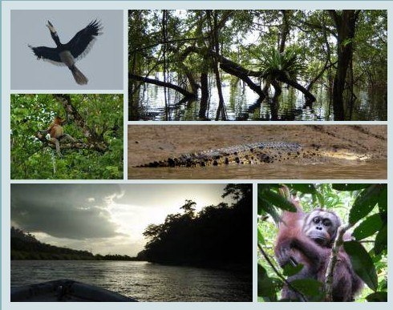
What is ecotourism?

Slide 4
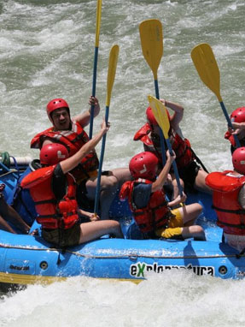
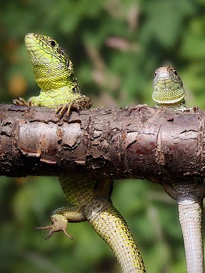
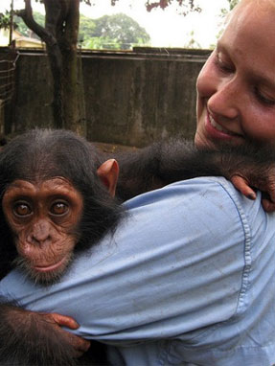
Types of nature based tourism
Adventure Tourism
Nature Tourism/ Wildlife Tourism
Ecotourism
Tourism “in” the environment
Tourism “about” the environment , flora & fauna
Tourism “for” the environment , flora, fauna & communities

Slide 5
Definition of ecotourism
The World Conservation Union describes ecotourism as “environmentally responsible travel and visitation to natural areas, in order to enjoy and appreciate nature and for any accompanying cultural features that promote conservation, have a low visitor impact and provide for beneficially active socio-economic involvement of local people”.

Slide 6
The power of ecotourism
The power of ecotourism:
“The ability and capacity to conserve life and nature in relatively undisturbed natural areas while enriching the lives of rural communities through responsible and sustainable tourism”

Slide 7
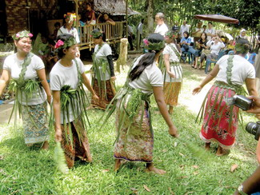
Obligations of Eco-Operators
ENGAGING
COMMUNITY
OBLIGATIONS
Sustainable Development

Slide 8
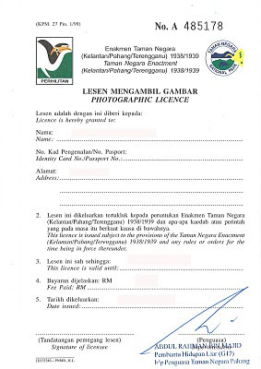
Obligations of Eco-tourists
ECOLOGICAL
CONSERVATION
OBLIGATIONS
Responsible Travel

Slide 9
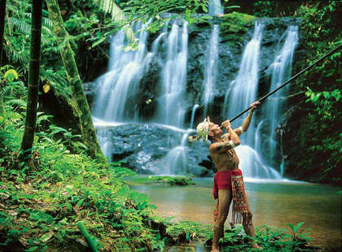
Core Principles of Ecotourism
ECOLOGICAL &
COMMUNITY
OBLIGATIONS
T O U R I S M
Sustainable & Responsible

Slide 10
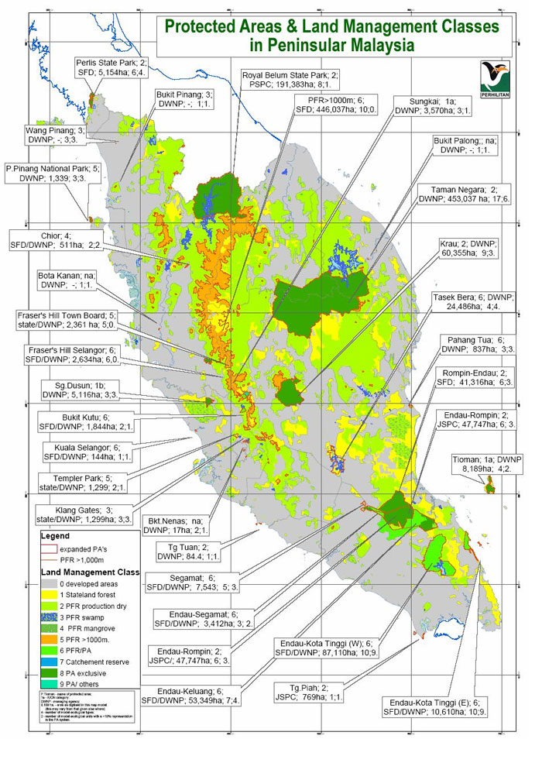
Protected Areas in Malaysia
60% of Malaysia’s total land area is under forest cover.
Malaysia is one of the world’s megadiverse countries. The other 2 in South East Asia is Indonesia and Philippines
The flora of Malaysia - about 15,000 species of higher plants. Ferns - over 1,100 many of which are endemic.
Vertebrates - 300 species of wild mammals, 700 to 750 birds, 350 reptiles, 165 amphibians and more than 300 freshwater fishes.
Invertebrates - more than 100,000 species.
Forested protected land - more than 5,000,000 hectares (equivalent to 7 times the size of Singapore) which covers watershed protected areas, wildlife sanctuary, and

Slide 11
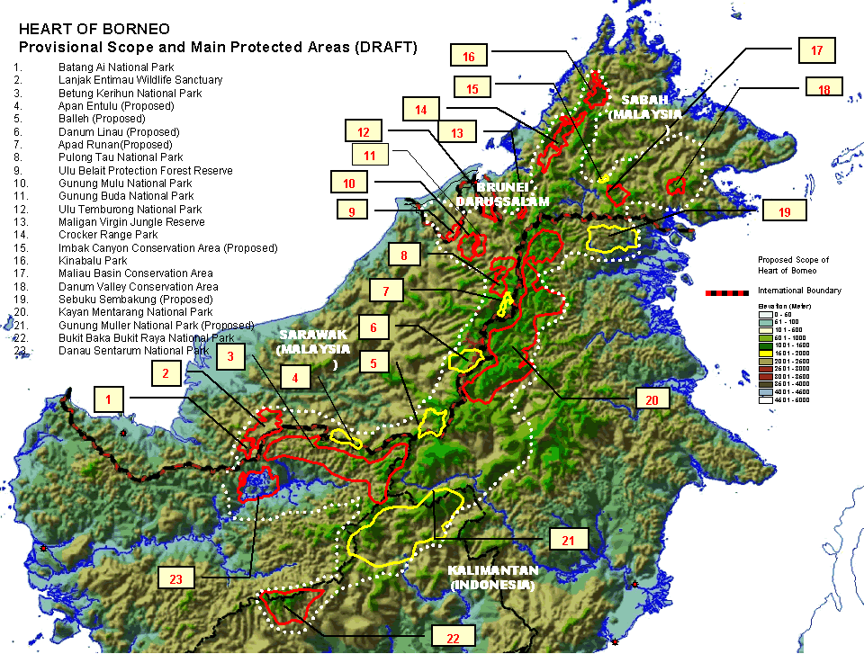
Protected Areas in Malaysia
23 terrestrial National and State Parks encompassing more than 850,000 hectares.
136 marine protected areas,
40 islands has been gazetted as marine parks.
Sectoral policies and laws governing biodiversity, such as
- National Forestry Policy,
- National Environment Policy,
- 3rd National Agriculture Policy,
National Wetlands Policy,
Forestry Act 1984, Wildlife
Protection Act 1972 and 2010,
National Park Act 1980 and Fishery Act 1985.
Totally protected forest areas - 15.3% of its land area.

Slide 12
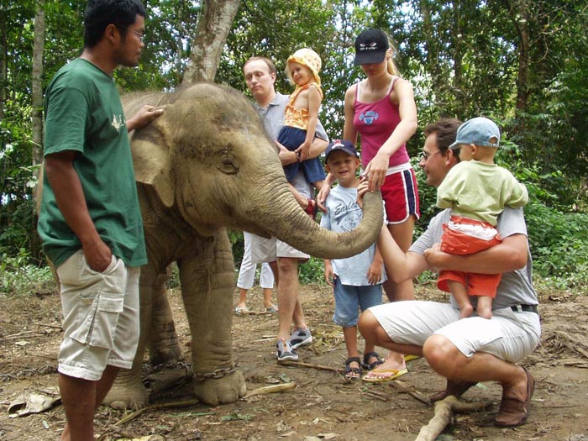
National Parks & Ecotourism Sites
(Department of Wildlife & National Parks)
Taman Negara Pahang National Park
Taman Negara Terengganu National Park
Taman Negara Kelantan National Park
Taman Negara Pulau Pinang National Park
Tasek Bera Ramsar Site
National Elephant Conservation Centre, Kuala Gandah, Pahang
Malacca Zoo
Gunung Benum
Wildlife Conservation Centre (River Terrapin), Bota Kanan, Perak
Paya Indah Wetlands, Dengkil, Selangor

Slide 13
Ecotourism destinations
Pahang Taman Negara National Park,
Kuala Gandah Elephant Sanctuary
Kenong Rimba Park
Selangor Sungai Chilling Waterfall, Kuala Selangor
Perak Royal Belum Forest Reserve
Gua Tempurung, Perak
Kuala Gula Bird Sanctuary
Penang National Heritage Park
Kedah Kilim Geopark, Langkawi
Terengganu Rantau Abang Turtle Hatchery
Redang Island Perhentian Island Gemia Island.
Sarawak
• Bako National Park
• Mulu National Park
• Niah National Park
• Batang Ai National Park
• Lampir Hill National Park
Sabah
• Sepilok Orang Utan Sanctuary
• Kinabalu National Park
• Tunku Abdul Rahman National Park
• Danum Valley
• Maliau Basin
• Tabin Wildlife Reserve
• Kinabatangan Floodplain, Sukau
• Turtle Island
• Gua Gomantong, Kinabatangan

Slide 14
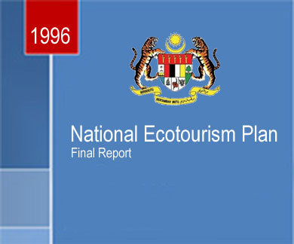
NATIONAL ECOTOURISM PLAN 1996
The National Ecotourism Plan will include the following elements of implementation:
(a) adopt and promote a clear definition of ecotourism;
(b) adopt and promote a clear policy on developing ecotourism;
(c) strengthen the Eco and Agro- Tourism Implementation Committee;
(d) implement legal changes to support implementation of the Plan; and
(e) establish a monitoring and evaluation programme.

Slide 15
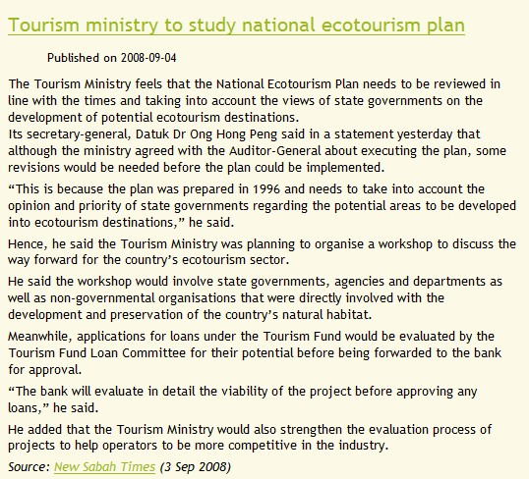
NATIONAL ECOTOURISM PLAN 1996
45 of the 60 eco-tourism areas approved under the Eighth and Ninth Malaysia Plans, were not "potential areas" as identified under the National Eco-Tourism Plan.
Implementation of eco-tourism projects under the Eighth Malaysia Plan was "less than satisfactory" with only half of the 20 projects completed
National Ecotourism Plan 1996 still yet to be re-evaluated to-date
Newspaper report in 2008

Slide 16
Malaysia’s ecotourism potential
Needs of eco-tourists
Environmental & Cultural Sustainability
Quality of Experience
Depending on the type of tourist
Accessibility &
Weather
Safety and
Health

Slide 17
Malaysia’s ecotourism potential
Needs of eco-tourists
Safety and
Health
1) Safe compared to other countries
2) Mobile connectivity is good
3) Health and safety regulations
4) Sheltered from natural adversities
5) Many rural areas have basic utilities and amenities

Slide 18
Malaysia’s ecotourism potential
Needs of eco-tourists
Accessibility &
Weather
1) Paved road network throughout
2) Public bus transport available in rural areas

Slide 19
Malaysia’s ecotourism potential
Needs of eco-tourists
Quality of Experience
Depending on the type of tourist
1) English is widely spoken in rural areas
2) Malaysia’s national & state parks are better managed
3) Malaysia is one of 3 countries in South East Asia are considered mega bio-diverse and among 17 in the world

Slide 20
Malaysia’s ecotourism potential
Needs of eco-tourists
Environmental & Cultural Sustainability
Establishment of the Malaysia Mega Biodiversity Hub
- Joint ministerial effort between Ministry of Tourism and Ministry of National Resources and Environment
Establishment of Malaysian Ecotourism Association
- Collaborative alliance between business sector, academic institutions and professionals

Slide 21
What are the challenges ahead?
MANAGEMENT
Lack of a workable National Ecotourism Plan that is business oriented
Need to identify ecotourism sites
DEVELOPMENT
Incorporation of cultural sustainability into ecotourism
BUSINESS
Demand and supply issues
High risks – inclement weather, climate change, natural adversities
Communication difficulty
Low price syndrome and low profit margins
STAKEHOLDERS
Lack of awareness and understanding of ecotourism by stakeholders
Lack of training and communication skills of stakeholders
FUNDING
Lack of government funds and infrastructure
LEGAL MATTERS
Remoteness and unclear boundaries of protected areas
Lack of enforcement either due to lack of manpower or funding

Slide 22
FLOOR VOTING
Initiatives for National Parks
Should it be mandatory that all national and state parks to print and distribute nature interpretative materials in the form of park notes and guides to enhance visitors’ ecotourism experience?
Yes No
Should National and State Parks in Malaysia be re-designated as National or State Conservation Parks instead, to shift the mindset of the public towards conservation and mandatory Conservation Fees be collected from visitors/tourists as a step towards sustainable tourism?
Yes No
Should National and State Parks offer conservation programmes and activities for volunteer ecotourism similar to Sepilok Orang Utan Sanctuary and Turtle Conservation Centre?
Yes No
Interpretative centres act as an additional attraction to enhance the value of ecotourism experience. Should it be mandatory for all nature-based tourism sites to have interpretative centres?
Yes No

Slide 23
FLOOR VOTING
Initiatives for Marketing
Do you think Internet technology and social media are the best marketing channels for ecotourism?
Yes No
Should nature/environmental conservation programmes and activities be marketed as ecotourism activities?
Yes No
Should ecotourism packages also include community based cultural attractions and activities for example homestay, local customs and traditions as well as local cuisine to expand and enhance the attractiveness of ecotourism?
Yes No
Should Ministry of Tourism and Tourism Malaysia shift their tourism and market development policies on ecotourism to high value luxury investments in rural areas promoting privacy and comfort, and targeting at tourist market segments with eco-centric profiles?
Yes No

Slide 24
Join the Malaysian Ecotourism Association
Concerned > Communicate > Collaborate > Cooperate > Connect > Contribute

Slide 25
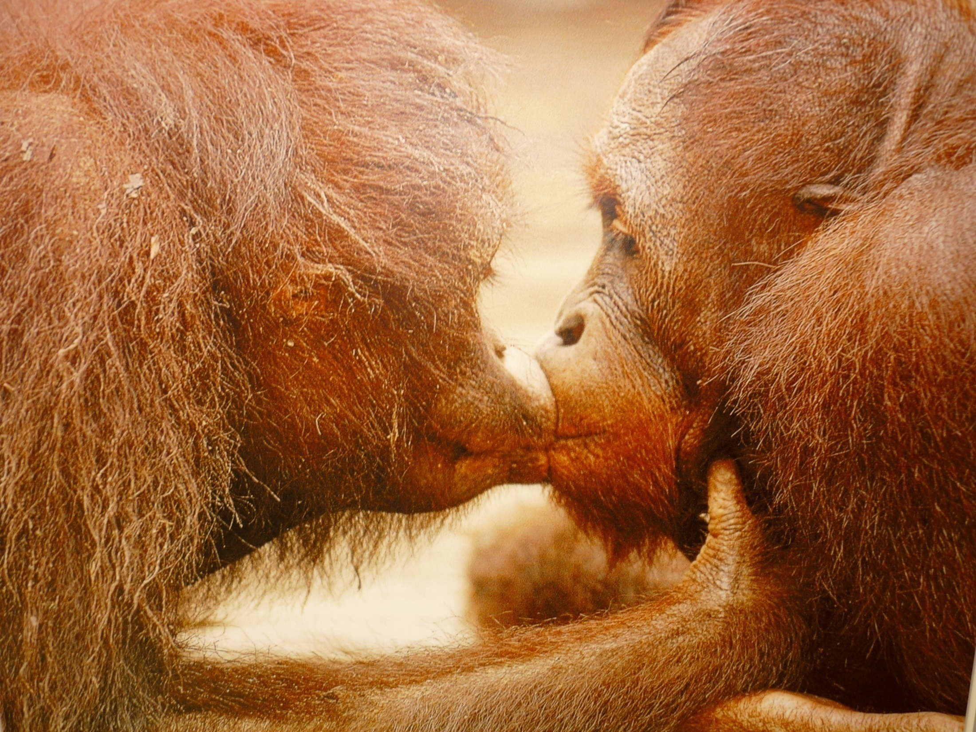
Affirmative public-private-people partnership
Role of Malaysian Ecotourism Association
Industry members support & networking
Information resources and knowledge base
MEMBERS’ ACTIVITIES
Marketing & Networking
Product Development
Capacity Building
Associations/ Cooperatives Set-ups
Government Funding
Leadership Nurturing
E-Business

Slide 26
Malaysian Ecotourism Association Activities
ASSOCIATION ACTIVITIES
MEA Seminar on Ecotourism for MOTOUR and NRE(2009)
World Ecotourism Conference 2010
Revitalisation of Rural Resources through Sustainable Tourism funded by MOF (MIDA)

Slide 27
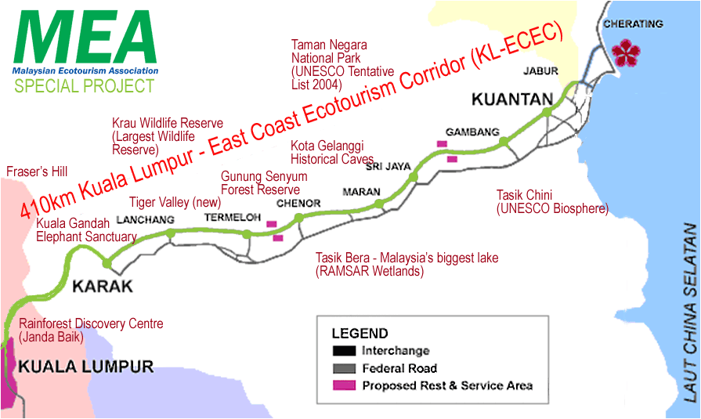
Kuala Lumpur –East Coast Ecotourism Corridor (KL-ECEC)
A Malaysian Ecotourism Association Initiative

Slide 28
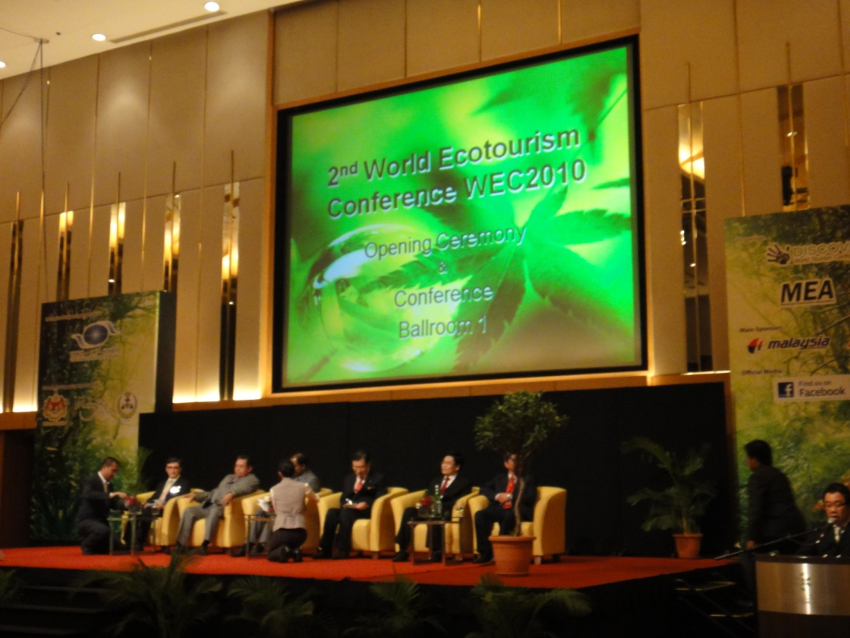
An affiliate member of
Urban Ecotourism &
Biodiversity Hotspots in
Developing Countries
Sustainability
Marketability
Resource Capacity
Business Practicability

Slide 29
Founder Organisation of the Asia Pacific Ecotourism Society
Supporting Organisation of World Ecotourism Conference
www.EcotourismMalaysia.org
Nominated Board Member of Malaysia Mega-Biodiversity Hub
Thank You!

